Slide 1
Programming with C and Python for Newbies
Day 3: Conditions: if ,else-if and else statements

Slide 2
Conditional statements
This are used to control the flow of our program based on some conditions
This allow us to make decisions and execute different blocks of code based on whether certain conditions are met.

Slide 3
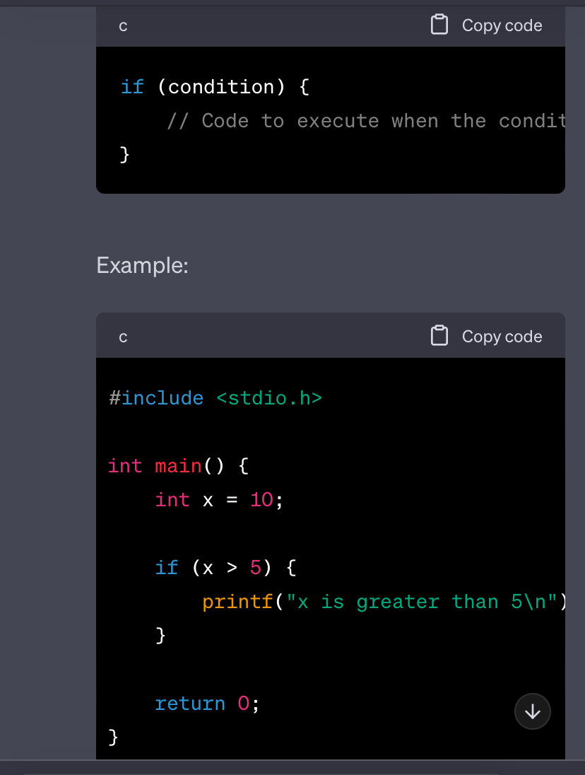
If statement
This allows you to execute a block of code only if a specified condition is true
Syntax

Slide 4
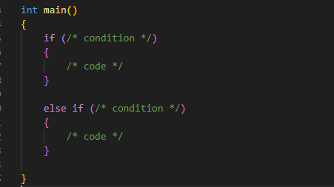
else if statement
This allows us to test multiple conditions
If the first if condition is not true it then checks the next condition which is the “else if” and so on.
Syntax

Slide 5
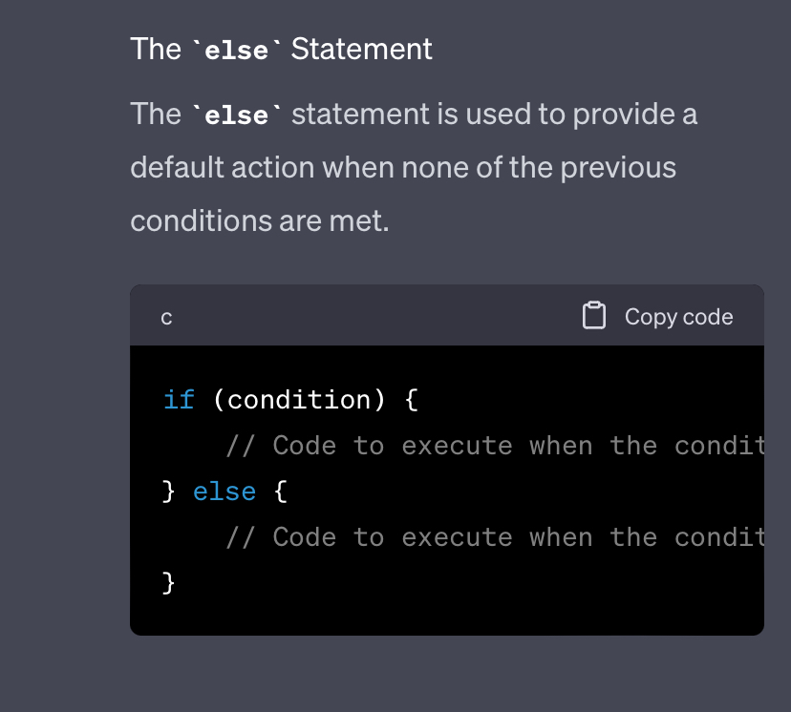
else statement
This is executed when none of the previous conditions are met.
Syntax

